Slide 1
Tilda- Getting started
2019-09-10

Slide 2
Intro
This presentation should allow you to get started with Tilda
Should take 1h to 90mn
Set up your development environment with Java, Eclipse, Tomcat and Postgres
Create a project
Learn the Tilda conventions to get started
Go through a simple yet non-trivial set of example to build an app
Pre-requisits
You need to be somewhat familiar with Java development and a Java IDE
You need some passing experience/familiarity with JSON
You need some passing experience/familiarity with SQL

Slide 3
General architecture
Tilda rests on human-readable and editable JSON-based model definitions that can be edited in any JSON-capable editor and are processed via a variety of command-line utilities:
Gen: validate the model(s), generate ORM code artifacts and searchable/navigatable HTML documentation
Docs: Outputs HTML and SQL documentation to the file system from the model(s)
The ‘T’ in Tilda stands for “Transparent”, and all artifacts are generated in human-readable form, fully commented and documented
Although Tilda allows to model complex data, the framework is architected from the ground up so that all artifacts generated are clear and clean so that the connection between an element in a Tilda definition file and its impact on the runtime or database is easy to see
Generated code relies heavily on the Java compiler to actualize in code many patterns, so that complex migrations (moving tables, changing indices, adding/removing columns etc…) has a direct compile-time impact that can then be easily remedied with standard code editors and refactoring methodologies.
The ‘I’ in Tilda stands for “Iterative”, and all processes and utilities when working with the framework encourage a fluid team-based iterative approach from design to deployment.
Migrate: migrates a database to the model(s)

Slide 4
Development Environment
For this tutorial, we’ll use the following software
Java SE JDK 11.0.3
https://www.techspot.com/downloads/5553-java-jdk.html
Apache Tomcat 9.0.24
http://tomcat.apache.org
Eclipse IDE for Enterprise Java Developers 2019-06 R
https://www.eclipse.org/downloads/packages/
PostgreSQL 11.5
https://www.postgresql.org/
Be aware that
There are no direct dependencies on Tomcat or Eclipse. Any Servlet container or Java IDE will do if you prefer something else.
Java 8 is the minimum requirement, but we like to use the latest and greatest
Postgres 9.6 is the minimum required, but we like to use the latest and greatest.

Slide 5
A Beginner’s Environment

Slide 6
A beginner’s Project
Different organizations have different standards in how they set up their Java-based projects.
We like to set up a base-line project where dependencies and environment configurations are set up and inherited from other projects where application code lives
The application will be composed of a few JARs and a really basic Web application
If you are a seasoned developer, then you might want to skim through this section very quickly to get set up.
This is really targeted at beginners, younger new employees and so on…

Slide 7
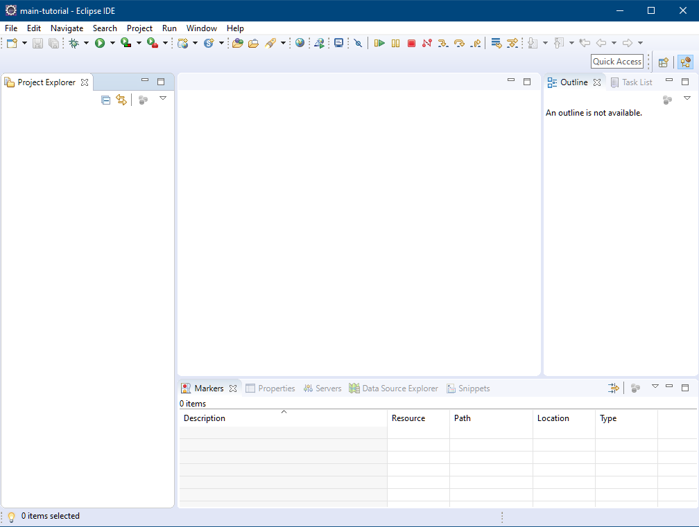
Starting with a clean Workspace
toolbar
perspectives
views

Slide 8
Simple customizations
I have never found a use for the Task List and Outline views.
The “Project Explorer” is nice, but I also like the “Navigator” as it gives you a view of projects that mirrors more closely the actual file system layout.
The “Console” view will be critical for us as we use many command-line utilities
Eclipse supports perspectives where you can customize the views you want. I have found this to not be as useful and like for example to have the “debugger” view in the main perspective
We’ll configure Tomcat and so we also need the “Servers” view.

Slide 9
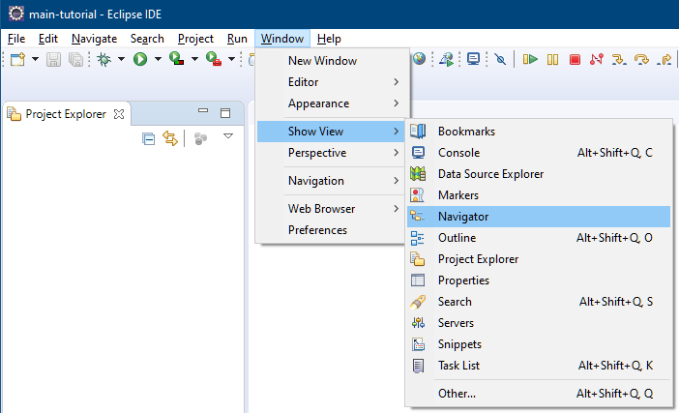
Extra views
You can add new views via the “Window” menu
Select “other…” to find the other views we like
You can then drag and drop your views according to taste

Slide 10
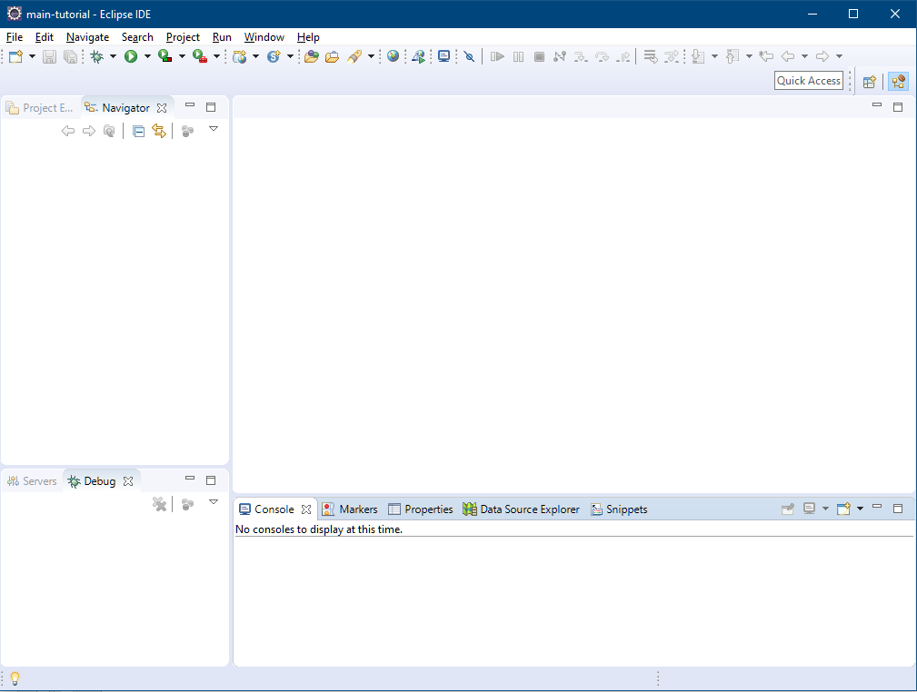
Optimized Perspective (according to someone!)
Project Explorer + Navigator
Main editors…
Servers + Debug
Console and other misc views

Slide 11
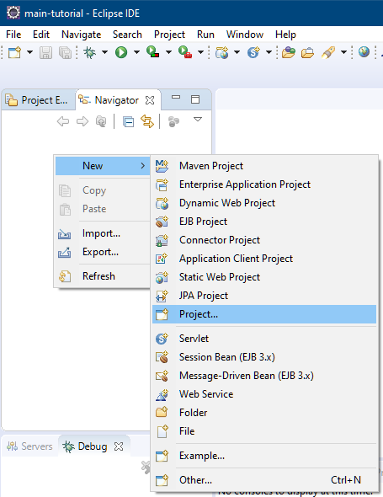
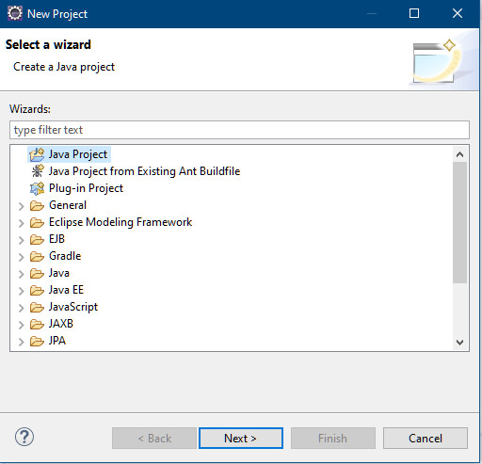
Create a “root” Project
The next few slides show the details of creating a root project.
Right-click in the Navigator.

Slide 12
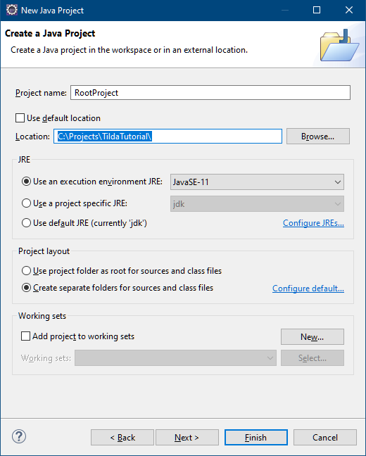
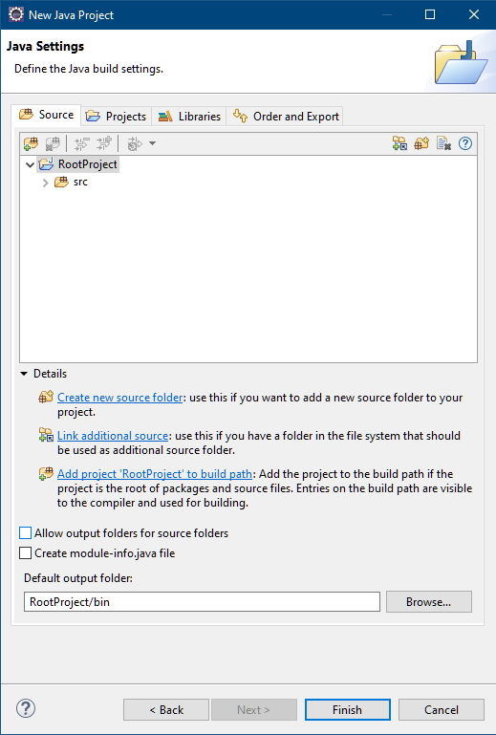
Create a “root” Project
“RootProject” name
C:\Projects\TildaTutorial
Disable the Module file

Slide 13
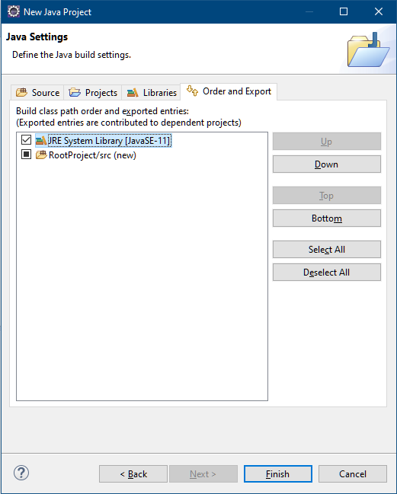
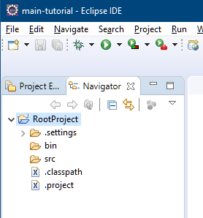
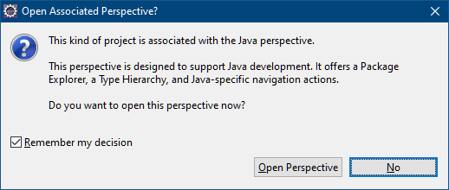
Create a “root” Project
Export the JRE and don’t switch perspective
select or Eclipse will keep bugging you!
choose no!

Slide 14
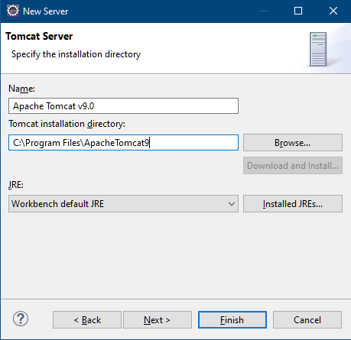
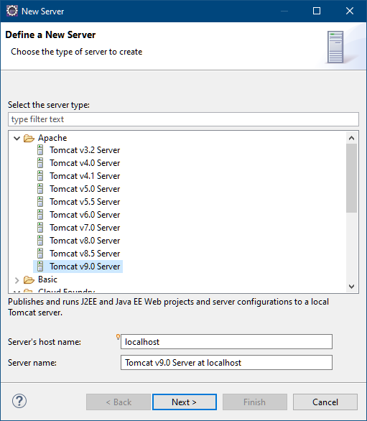
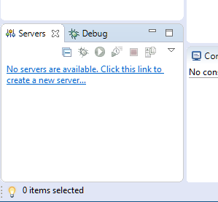
Set up tomcat
On the “Servers” view, add a new server
pick where you installed Tomcat

Slide 15
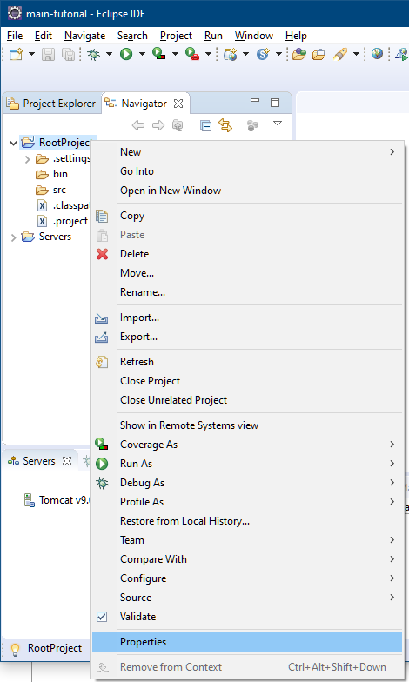
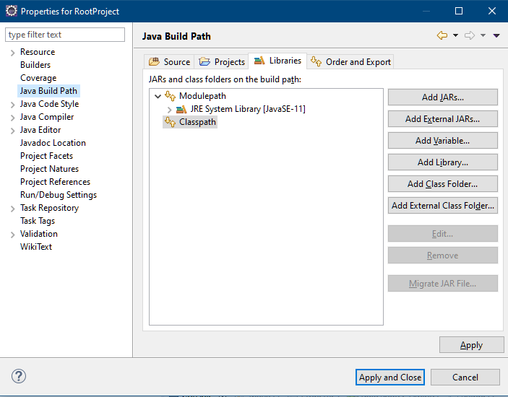
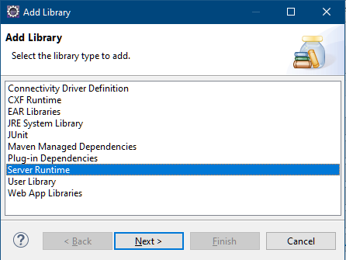
Set up tomcat
Right click on “RootProject” and select “Properties”
“Java Build Path”, “Libraries”, “Add Library”

Slide 16
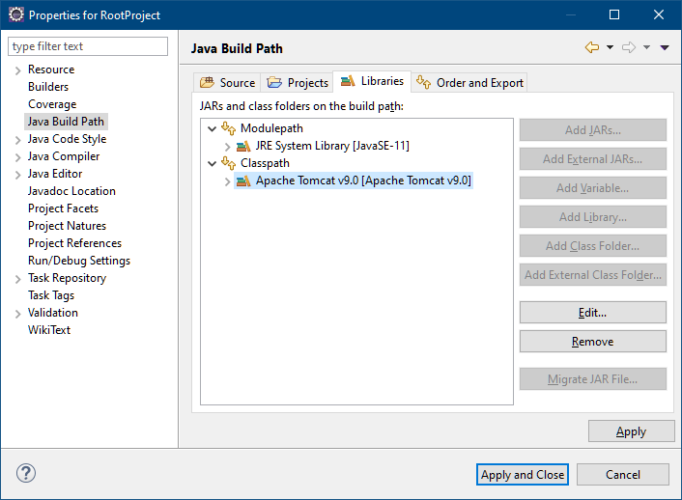
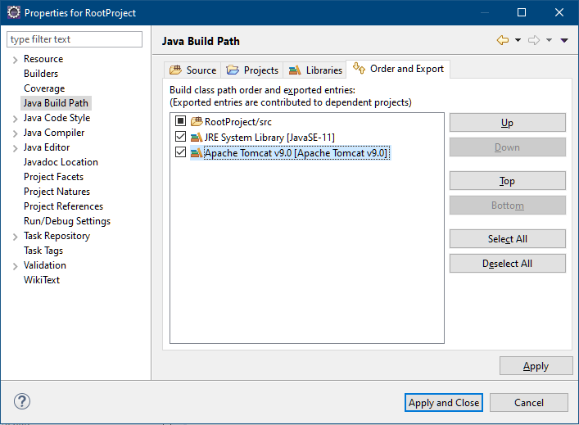
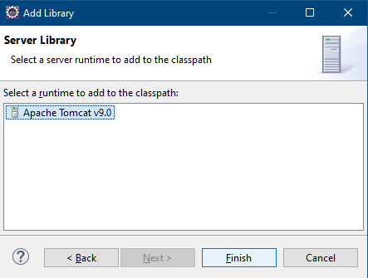
Set up tomcat
Select Tomcat 9
Export
Apply And Close

Slide 17
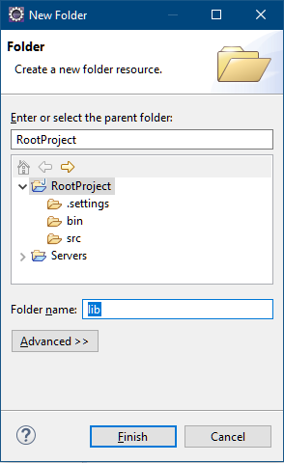
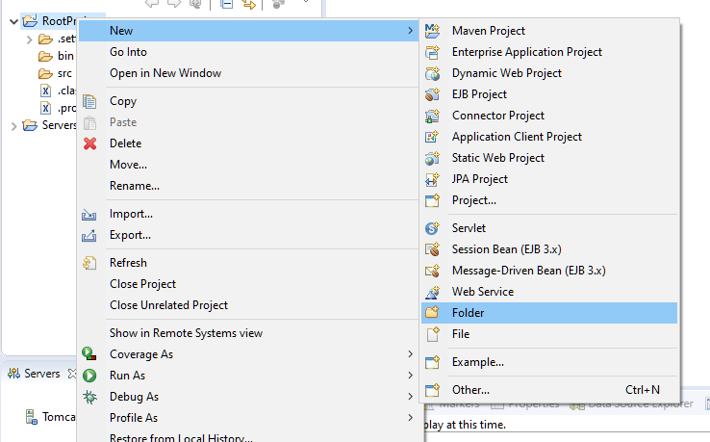
Add the Tilda Libraries
Add a “lib” folder to the project

Slide 18
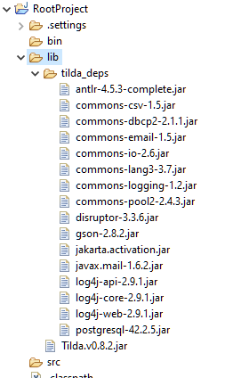
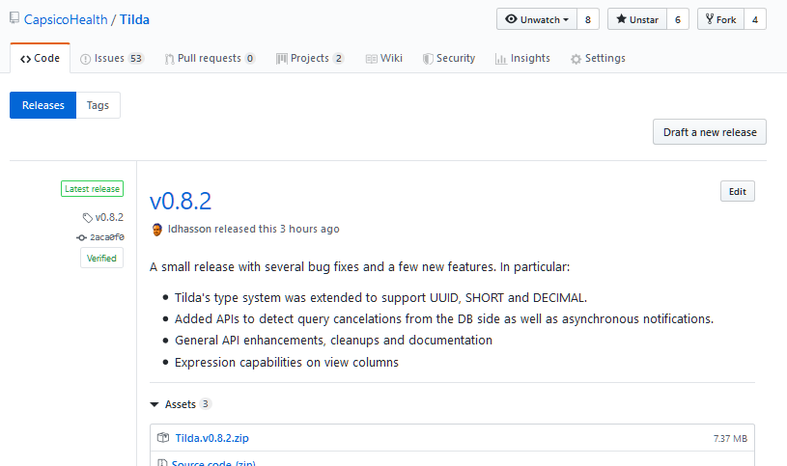
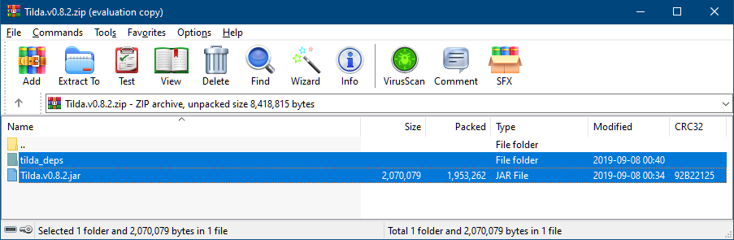
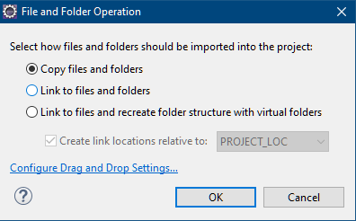
Add the Tilda Libraries
Download the latest Tilda release
https://github.com/CapsicoHealth/Tilda/releases
Drag’n’Drop the contents of the Zip to the “lib” folder

Slide 19
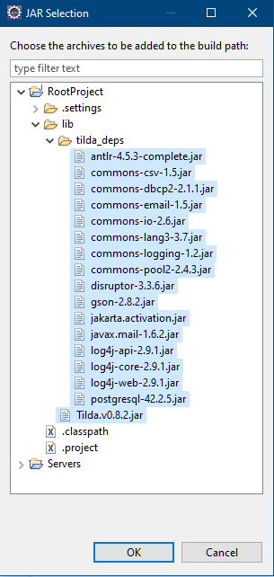
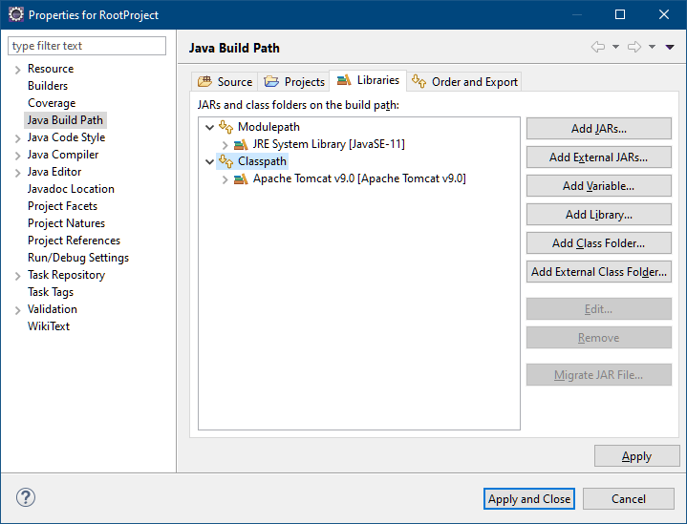
Add the Tilda Libraries
Right click on “RootProject”, select “Properties”, “Java Build Path”
Select “Libraries”, “Add JARs”

Slide 20
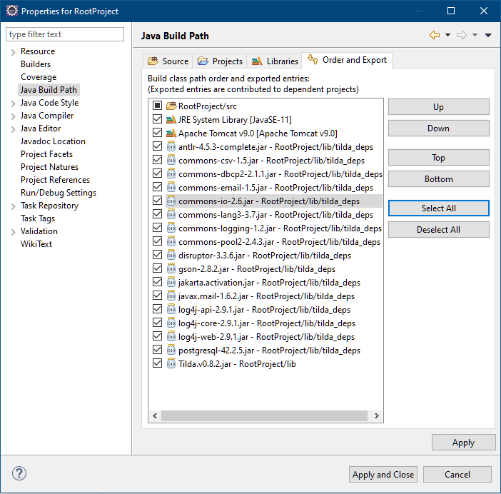
Add the Tilda Libraries
Export all
Apply and close

Slide 21
First Tilda Project

